Slide 1
Electric Water Heating Cooling System master
By:
Ahmed Sayed Mahmoud Hassanin Abdallah Magdy Ramadan

Slide 2


Slide 3

.
INTRODUCTION .......................................................................................................2 SYSTEM OVERVIEW ..............................................................................................3 SYSTEM ARCHITECTURE .......................................................................................6 SYSTEM OPERATION ............................................................................................7 SYSTEM FLOWCHART .........................................................................................13 REFERENCE AND ACKNOWLEDGMENT ..............................................................14

Slide 4

.
Structure of the document and its assets The electric water heating system is an embedded software system project, that aims to solve a common problem in factories and big industrial entities, where the main function is to maintain a stable temperature degree to a certain element. It is not a boiler or a cooler. It is a controllable container that is responsible to keep the container content (whether it is industrial or comical materials) at a preselected temperature degree. This system is responsible for turning the heating or the cooling system to keep the container content's desired temperature stable. Additionally, it allows the user to redesign the desired temperature as it suits his need best. The requirements of this project were selected carefully by professional experts in the field of software embedded systems. And we worked hard in our company to fulfill the specifications of each system as required. This report is prepared after a long studying of each system's specifications and requirements, building each system individually, integrating these systems into one application then testing the results, and comparing them all together. However, the actual targeted audience besides the professional acceptance committee is everyone really interested in the embedded systems, and later this report will be updated with test cases done during the building and testing process to demonstrate the techniques used for those who are interested in software testing.

Slide 5
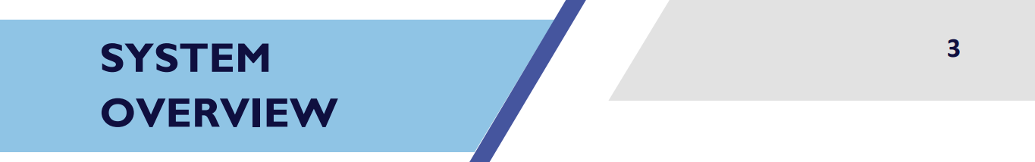

.

Slide 6
Electric water heating system, this system has been designed and built for low power Atmel AVR eight-bit high-performance RISC architecture microcontroller. The module used in this project is ATmega32 with: • 32 programmable I/O lines. • 4.5V - 5.5V operating voltage. • 0 - 16MHz speed grades. • 1024 Bytes internal EEPROM. • Two 8-bit Timer/Counters. • One 16-bit Timer/Counter. • 8-channel, 10-bit ADC. • Byte-oriented Two-wire Serial Interface. • External and Internal Interrupt Sources. • Six Sleep Modes: Idle. And more of which we did not use in this project. As for the interface with the user, A Liquid Crystal Display, two Seven Segments Display, and three Push Button Switches.

Slide 7

An electric water heating system is built from several smaller systems or modules, each with a special purpose, behavior, and specifications that we will describe and discuss in this section. All these systems combined to complete the purpose of the project, and we need to outline the requirements that we met in this project in the bargain of the system reliability, readability, and efficiency of giving a solution to the given problem. Without further _delay_ms (); The electric water heating system’s application features encapsulate its serviceability and usability. The ordinary user who has no development background can easily understand the behavior, factuality, and activities of the application. The system has four modes of operation, [STARTING] mode, [ON_STATE] mode, [SETTING_STATE] mode, and [OFF_STATE] mode. When the system is powered up it enters the [STARTING] mode where the system modules are initiated, and a welcome message is displayed on the LCD. Then the user needs to activate the system by pressing the [ON_OFF_SWITCH], this action gives the system the command to enter the [ON_STATE] mode if the user needs to modify the set temperature which is initialized by default to [60 Celsius], the [SETTING_STATE] mode must be activated by pressing either the control push button switches [UP_SWITCH] or [DOWN_SWITCH]. The system is automatically exiting the [SETTING_STATE] mode to the [ON_STATE] mode after five seconds [5 sec] of control push button switches not being activated/pressed. Pressing the [ON_OFF_SWITCH] during the [ON_STATE] mode or the [SETTING_STATE] modeled the system to enter an Idle sleep [OF_STATE] mode. The system is being activated back after entering the sleep [OFF_STATE] mode, by pressing the [ON_OFF_SWITCH]. The system during the [ON_STATE] mode is responsible for sensing the temperature of the liquid inside the container every one-hundred mile second [100m sec] then displays the average of the last ten readings to the user monitor [SEVEN SEGMENTS and LCD]. If the liquid temperature decreases than the set temperature by five degrees the system turns on the heating system [3d ceramic heater] and the LED system [Heating Element LED] is blinking every one second [1 sec], pending the liquid temperature reaches the set temperature, diversely is the liquid temperature increased than the set temperature by five degrees the system turns on the cooling system [Peltier] and the LED system [Heating Element LED] is turned on pending the liquid temperature reaches the set temperature. Otherwise, if the liquid temperature equals the set temperature, then the heating system [3d ceramic heater], the cooling system [Peltier], and the LED system [Heating Element LED] are turned off. During the [SETTING_STATE] mode, the set temperature is being displayed in addition to a welcoming message on the LCD, pressing the [UP_SWITCH] increase the set temperature by five degrees [5 C], while pressing the [DOWN_SWITCH] decrease the set temperature by five degrees [5 C]. Then the new set temperature is displayed on both the [LCD] and the two [SEVEN SEGMENTS] -which blink every five seconds [5 sec]- and saved in the system memory as the set temperature of operation is updated to be used after the system is turned. Entering the sleeping [OFF_STATE] mode disables the monitoring systems [LED_SYSTEM], [LCD], and [SEVEN SEGMENTS]. The system is activated back if the [ON_OFF_SWITCH] is pressed during this mode to the [ON_STATE] mode.

Slide 8

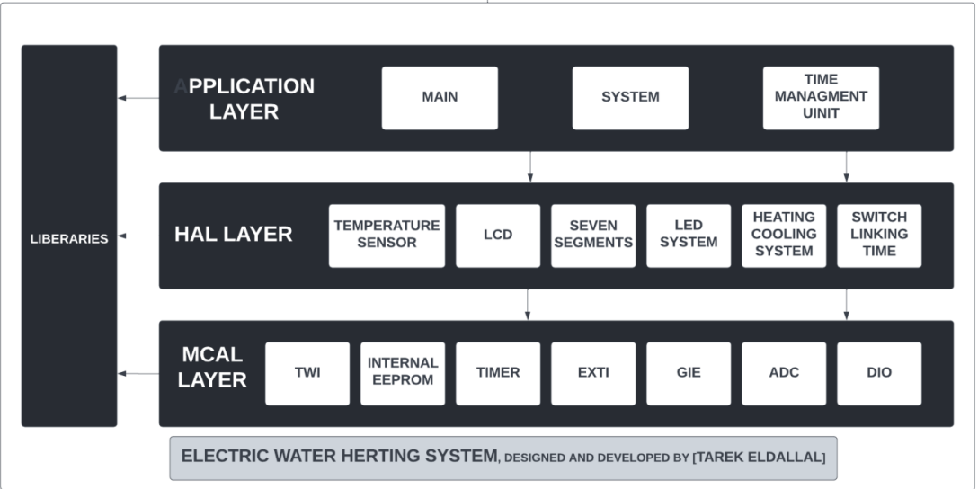
.
[1] SOFTWARE ARCHITECTURE :

Slide 9
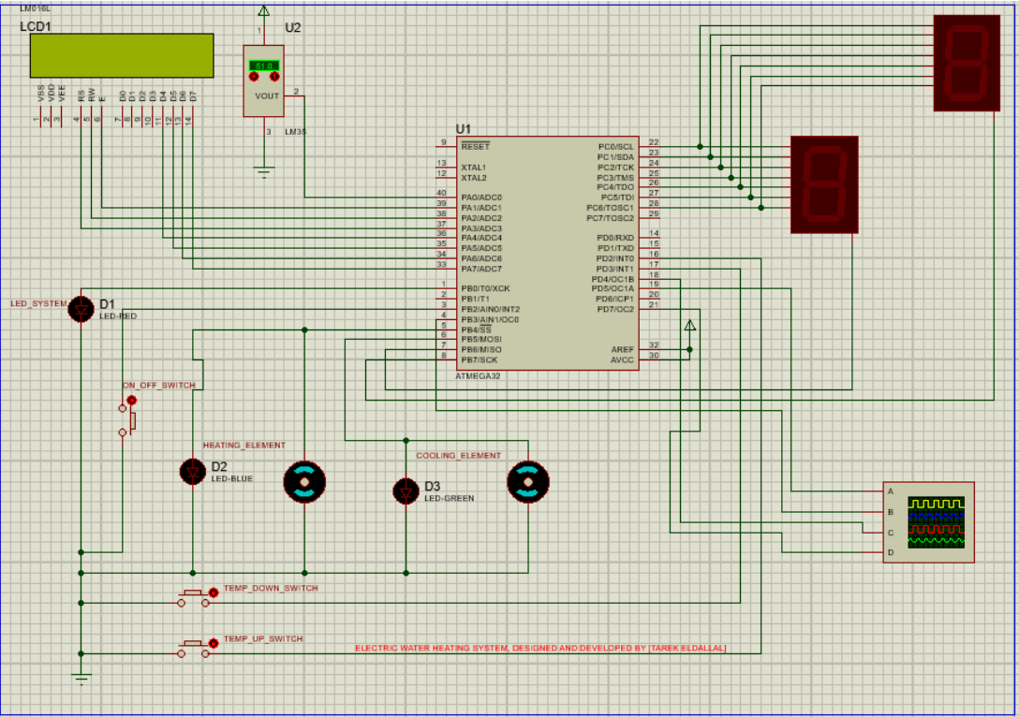
[2] HARDWARE ARCHITECTURE [3] SYSTEM OPERATION [POWER OFF]

Slide 10
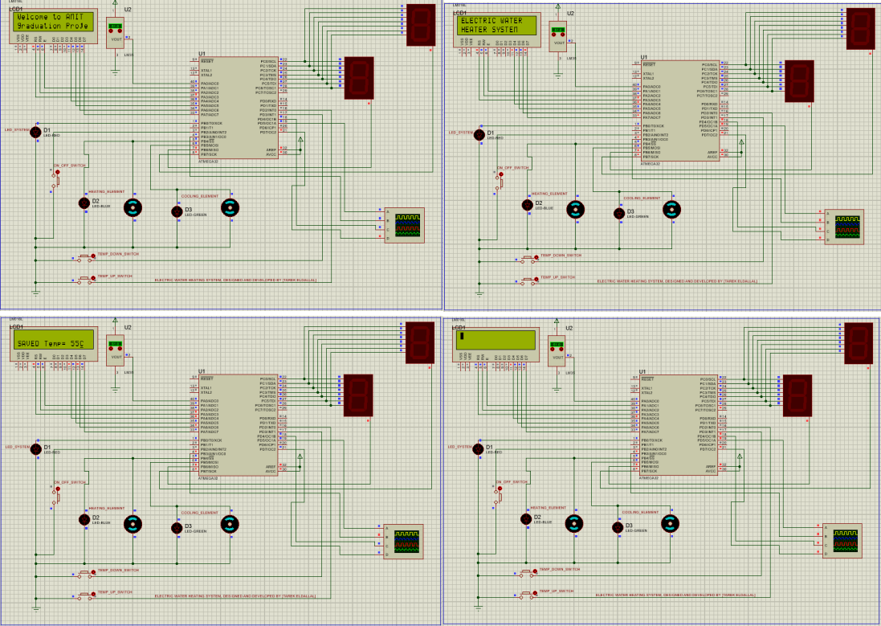
[C] SYSTEM OPERATION [STARTING MODE]

Slide 11
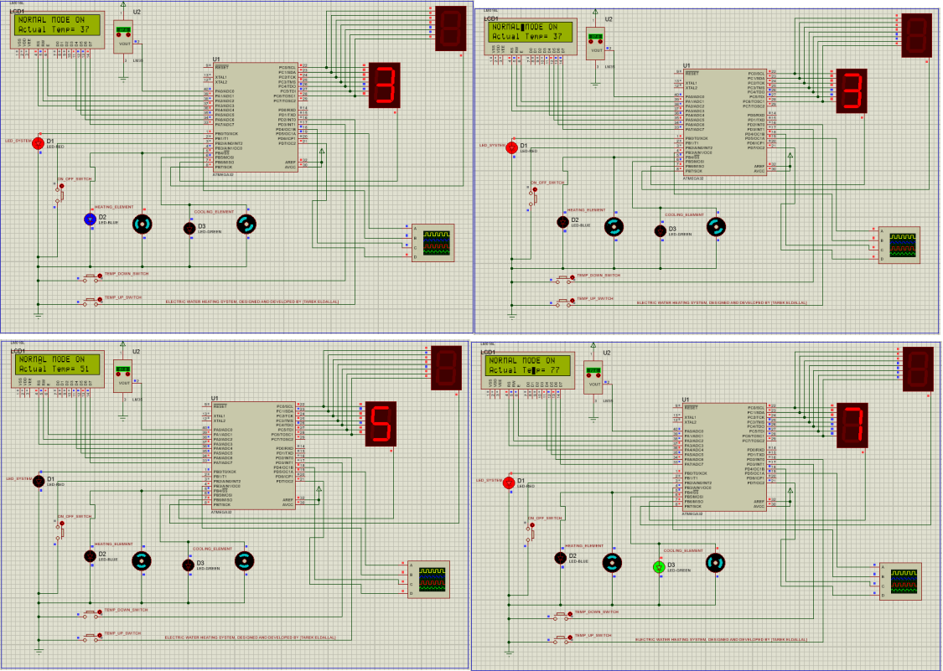
[D] SYSTEM OPERATION [ON_STATE MODE]

Slide 12
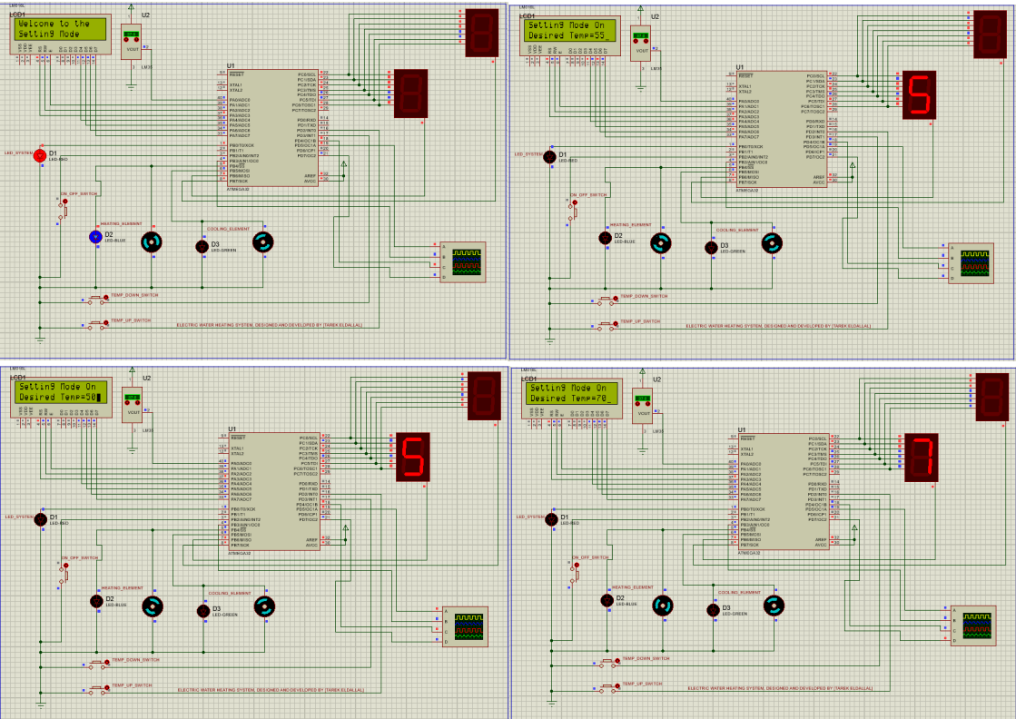
[D] SYSTEM OPERATION [SETTING_STATE MODE]

Slide 13
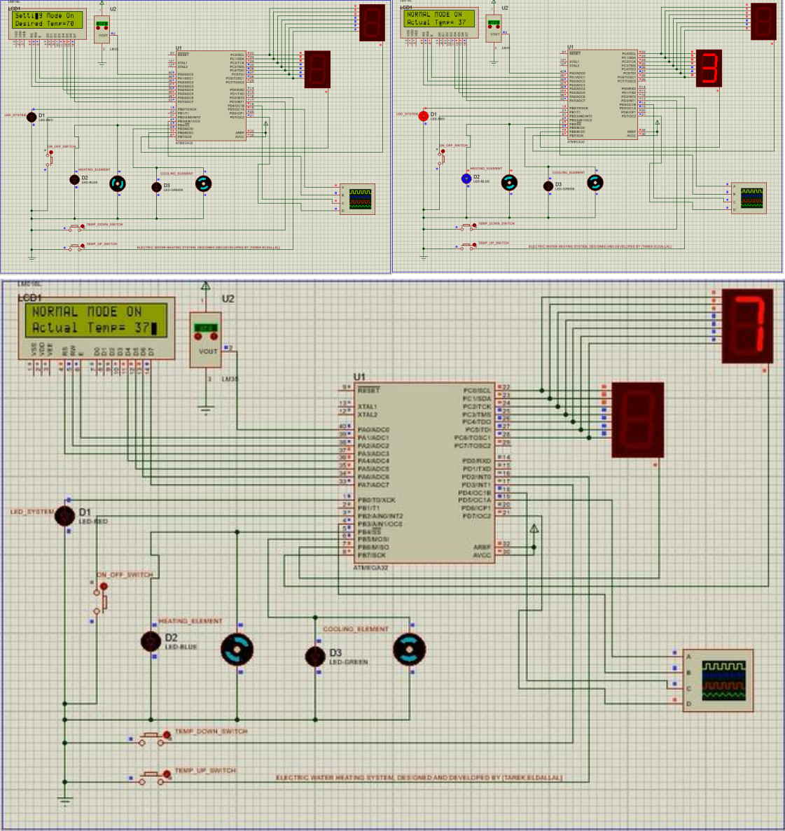
[E] SYSTEM OPERATION [SETTING_STATE MODE TO ON_STATE MODE] [AFTER 5 SECONDS OF NOT PRESSING UP|DOWN_SWITCH]

Slide 14
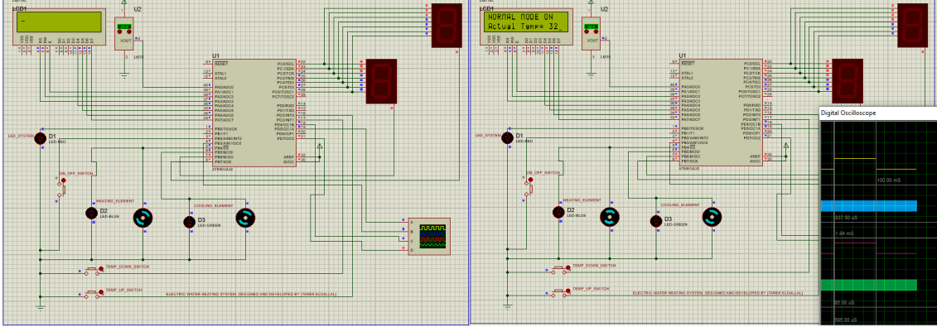
[F] SYSTEM OPERATION [OFF_STATE MODE TO ON_STATE MODE]

Slide 15
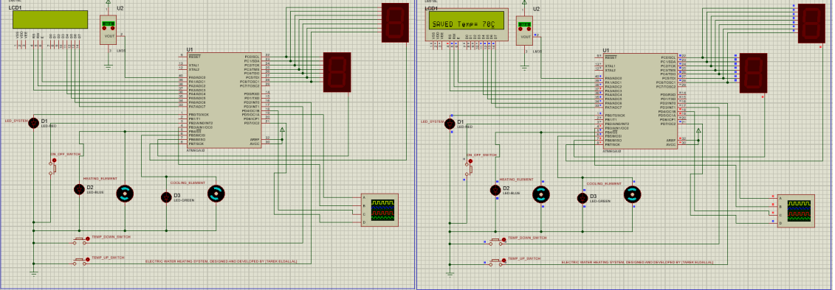
[F] SYSTEM OPERATION [POWER OFF THEN POWER BACK ON]

Slide 16
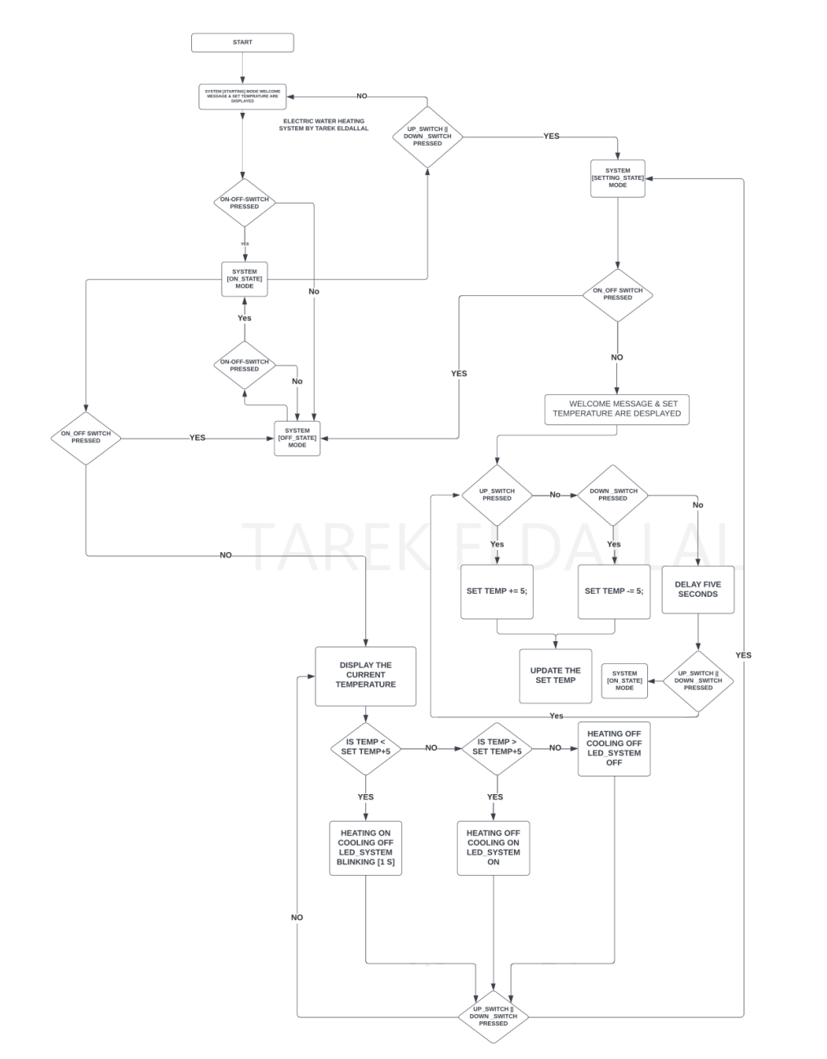
SYSTEM FLOWCHART

Slide 17
ACKNOWLEDGMENT
THIS REPORT WAS WRITTEN AFTER FOUR MONTHS EMBEDDED SOFTWARE DIPLOMA FROM AMIT LEARNING. DURING THIS DEPLOMA WE WERE EDUCATED AND INSTRUCTED BY SEVERAL OUTSTANDING ENGINEERS, TO WHOM I AM VERY THANKFUL.

Slide 18
THE ELECTRIC WATER HEATING SYSTEM, IS AN EMBEDDED SOFTWARE PROJECT MADE TO PRACTISE WHAT WAS LEARNED DURING THE EMBEDDED SYSTEMS DIPLOMA AND BEFORE.
THE PROJECT AND THIS REPORT WERE DESIGNED AND IMPLEMENTED BY:
AHMED SAYED MAHMOUD HASSANIN
ABDULLAH MAGDY RAMADAN.

